Slide 1
Introduction to Information Coding
Dr Laura Toni
l.toni@ucl.ac.uk
University College London

Slide 2
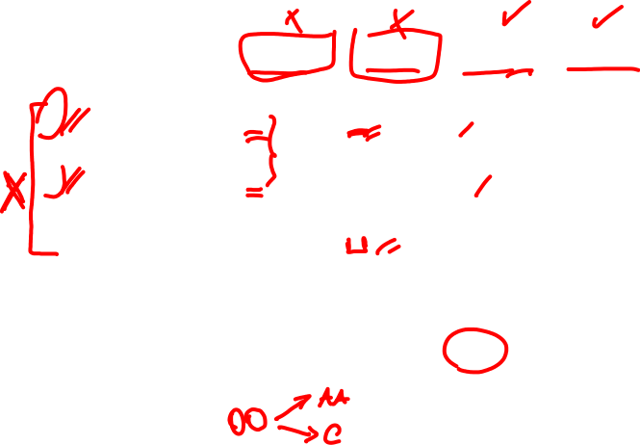
Examples of Codes
Input letter | Prob. | Code 1 | Code 2 | Code 3 | Code 4
A | 1/2 | 0 | 0 | 1 | 0
B | 1/4 | 0 | 1 | 01 | 01
C | 1/8 | 1 | 00 | 001 | 011
D | 1/8 | 10 | 11 | 000 | 0111
L(C) |  | 1.125 | 1.25 | 1.75 | 1.875

Slide 3
Problems with these codes
Code 1: Two input symbols have the same codeword
Code 2: This problem is fixed. But suppose the decoder receives 00. What was the input? C or AA?
Codes 3 and 4 look OK. Code 3 is shorter.
Is that the best we can do?

Slide 4
More Examples of Codes
Input Letter | Singular | Non-sing Not U.D. | U.D. Not prefix | Prefix (Instant.)
A | 0 | 0 | 10 | 0
B | 0 | 010 | 00 | 10
C | 0 | 01 | 11 | 110
D | 0 | 10 | 110 | 111

Slide 5
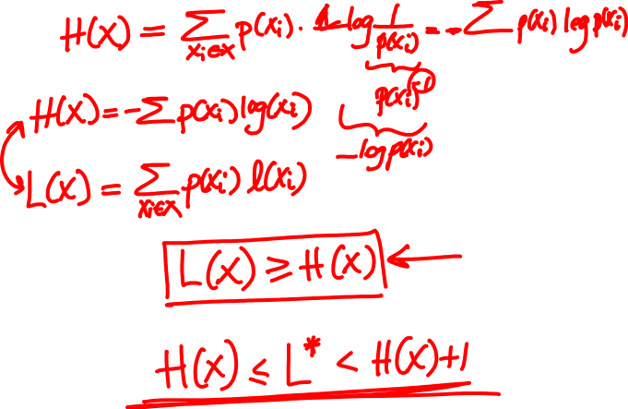
Optimal Code

Slide 6
Optimal Code

Slide 7
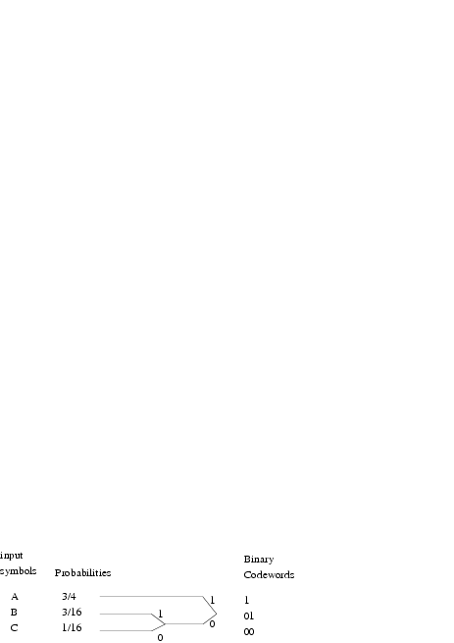
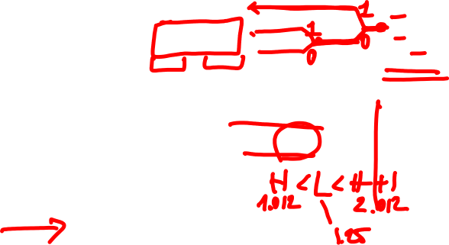
Huffman Coding Example
Example:
The entropy of the source is H = 1.012 bps
Average length of this code is L = 1.25 bps
The efficiency of the code is:

Slide 8
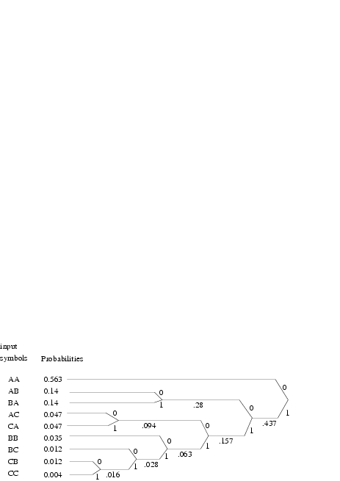

Huffman Coding Example Extended
If we take pairs, get more efficient code:
Expected length now 1.0375 bps
Efficiency is up to 1.012/1.0375 = 0.97
Code/decode the message: AAABAAAAACBAAABA

Slide 9
EXAMPLE
AA
.563
AB
.14
0
0
.28
1
BA
.14
1
0
AC
.047
.437
0
.094
CA
.047
1
1
0
BB
.035
.157
0
1
BC
.012
.024
.063
0
1
CB
.012
1
0
.028
x | C(x) | p(x) | l(x)
AA | 0 | .563 | 1
AB | 100 | .14 | 3
BA | 101 | .14 | 3
AC | 1101 | .047 | 4
CA | 1101 | .047 | 4
BB | 1110 | .035 | 4
BC | 111101 | .012 | 6
CB | 111101 | .012 | 6
CC | 11111 | 0.004 | 5
CC
.004
.004
1
L(x)=2.0830

Slide 10
EXAMPLE
AA
.563
AB
.14
0
0
.28
1
BA
.14
1
0
AC
.047
.437
0
.094
CA
.047
1
1
0
BB
.035
.157
0
1
BC
.012
.024
.063
0
1
CB
.012
1
0
.028
x | C(x) | p(x) | l(x)
AA | 0 | .563 | 1
AB | 100 | .14 | 3
BA | 101 | .14 | 3
AC | 1101 | .047 | 4
CA | 1101 | .047 | 4
BB | 1110 | .035 | 4
BC | 111101 | .012 | 6
CB | 111101 | .012 | 6
CC | 11111 | 0.004 | 5
CC
.004
.004
1
L(x)=2.0830

Slide 11
Outline
Introduction to Information compression
Source Coding
Information and Entropy
Variable length coding
Quantization
Multimedia Systems
Image and Lossy Compression
Transforms
JPEG Quantization
JPEG Lossless Compression
Video Compression
Motion Compensation

Slide 12
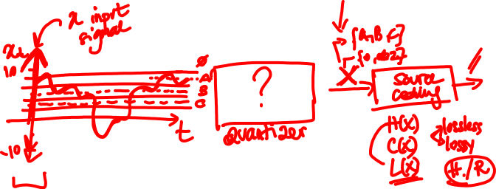
Why do we need quantization?

Slide 13
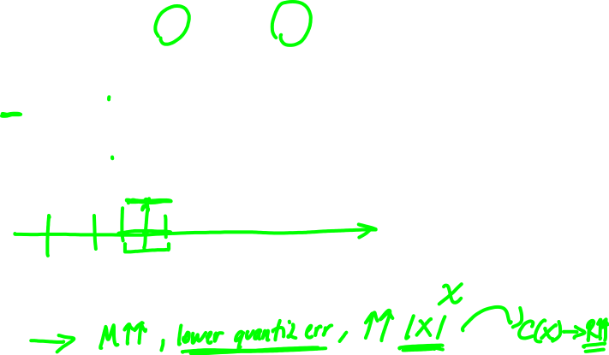
Scalar Quantization (SQ)
= r_{q+2}
= r_{q+1}
= r_{q}

Slide 14

Example of Quantized Waveform

Slide 15
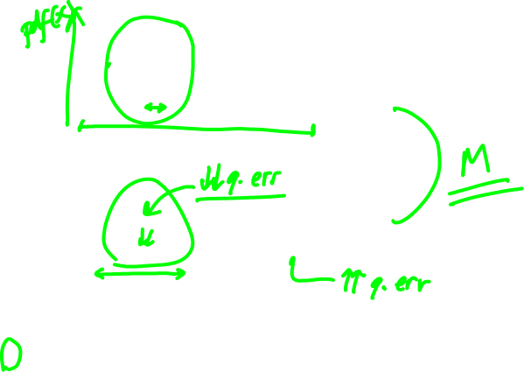
Scalar Quantization
Uniform quantization is not always the best

Slide 16
Scalar Quantization
X(t)
P(x)
3
2
1
t
1
2
3
x
Most of the data are focused around 1.5-2.5 values
Only few samples will be around 0- 0.5 range

Slide 17
Scalar Quantization
X(t)
P(x)
3
2
1
t
1
2
3
x
X(t)
X(t)
3
3
2
2
1
1
t
t
Uniform quantization
Non uniform quantization

Slide 18

Signal and Distribution
X(t)
P(x)
3
2
1
t
1
2
3
Signal over time
x
PDF of the x
$$\hat{x}$$
2.5
1.5
Input and output mapping of a quantizer
0.5
1
2
3
X

Slide 19
Thank You

